Slide 1




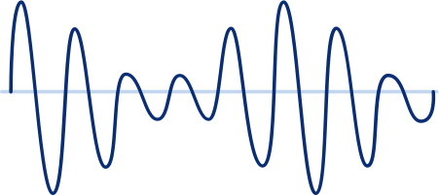


AN INTRODUCTION TO
Types of Waves

Slide 2


Earthquakes are waves we can feel!
Some of these waves cause the ground to shake up and down (S-waves) or side to side (P-waves).
In this lesson, we will learn more about waves and their types.

Slide 3


Learning Outcomes
  Define what a wave is.
  Differentiate transverse from longitudinal waves.
  Cite examples for each wave type.

Slide 4

What Is a Wave?
A small drop of water on a calm water surface can create ripples.
  It is a series of vibrations or oscillations traveling from one point to another.
  It carries energy without transferring matter.

Slide 5

TYPES OF WAVES:
Transverse Wave
vibrations of particles are perpendicular to the direction of travel
crest
vibration
amplitude
direction of travel
trough
wavelength

Slide 6

TYPES OF WAVES:
Longitudinal Wave
vibrations of particles are parallel to the direction of travel
vibration
direction of travel
compression
rarefaction

Slide 7

Slinky Wave Models
Let's think. How could you use a Slinky to demonstrate how transverse and longitudinal waves behave?

Slide 8
Examples of Waves
Transverse
Longitudinal
  light waves ripple on a water surface
  Slinky moving up and down
  S-waves
  sound waves
  Slinky move back and forth
  P-waves

Slide 9


Wrap Up
Transverse Wave
Longitudinal Wave
Wave
vibrations or oscillations traveling in space
particles vibrate perpendicular to the direction of travel
particles vibrate parallel to the direction of travel

Slide 10
Reference
  CK-12. "Waves and Wave Properties." Retrieved November 20, 2022 from https://www.ck12.org/book/ck-12-physics---intermediate/section/10.4/

